Slide 1

USERNAME AND EMAIL VALIDATION SYSTEM
Using Regular Expressions (Regex), Python Functions and Tkinter GUI
Project: Student Login Validation System
Presented by: Tirth Faldu (12502080603019)
Class: IT-A batch (1A8)
Language: Python
Core concepts: Regular Expressions, functions and graphical user interface
Purpose: Validate a 10-digit enrollment number and an ADIT college email address

Slide 2
PROJECT OVERVIEW
Objective and validation workflow
Accept the user's enrollment number and college email through a desktop form.
Use regular expressions to check whether both inputs follow the required format.
Display a clear error message when an input is empty or invalid.
Show a success alert only when both fields pass validation.
The Clear button empties the form and removes old error messages.

Slide 3
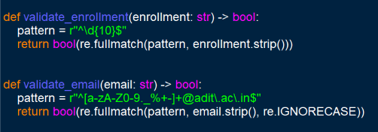
REGEX AND VALIDATION FUNCTIONS
The core rules are implemented in two reusable functions
^\d{10}$ : exactly 10 digits.
@adit\.ac\.in : requires the college domain.
strip() removes spaces at the beginning and end.
fullmatch() checks the complete input.

Slide 4
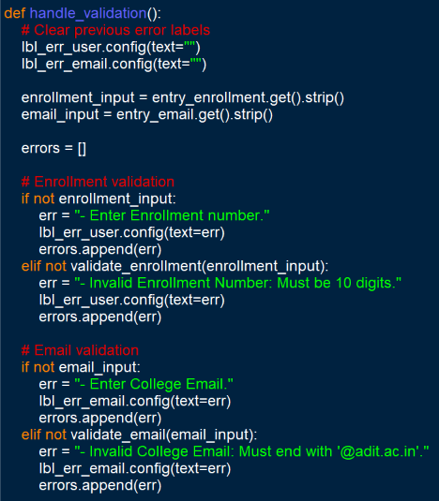
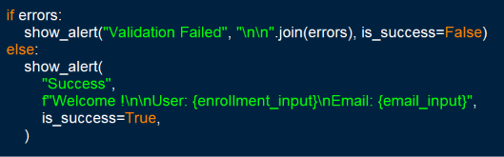
GUI AND VALIDATION LOGIC
Tkinter connects the input fields, buttons and messages

Slide 5
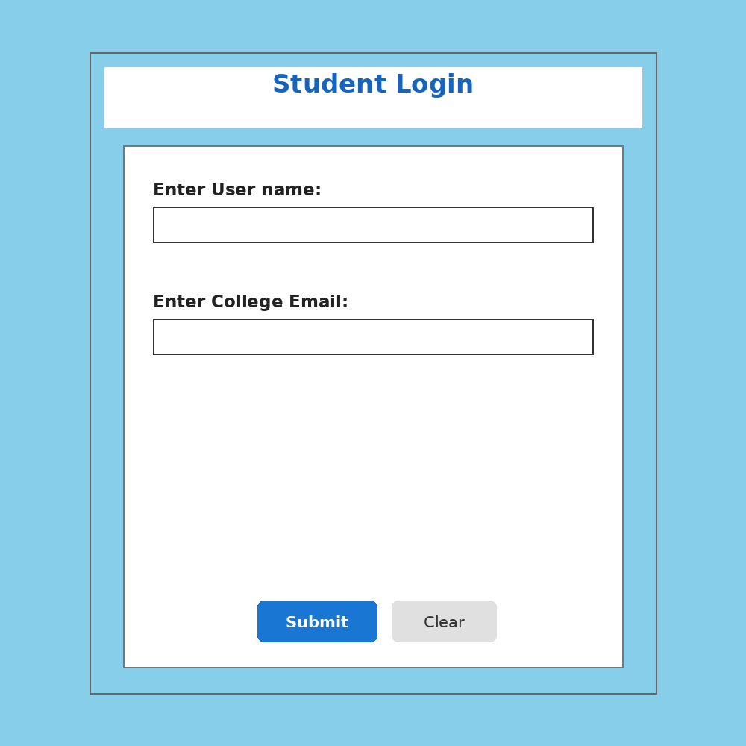
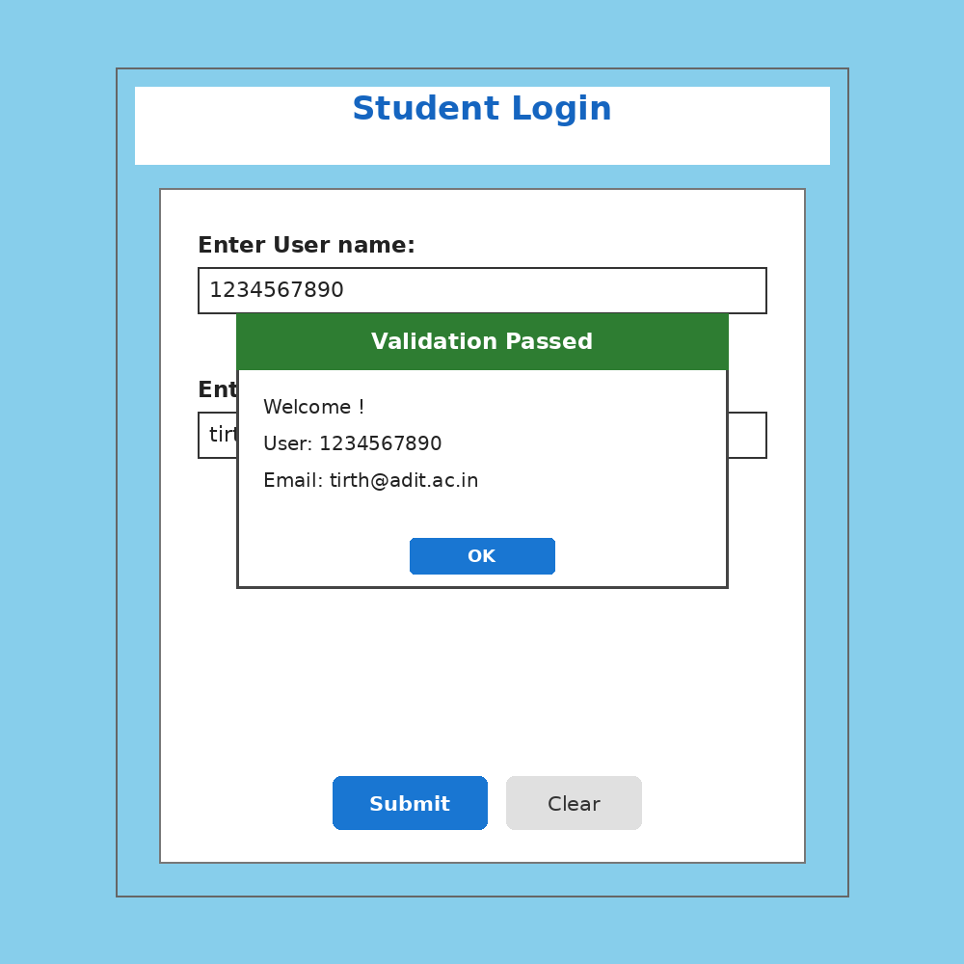
OUTPUT: STUDENT LOGIN GUI
The form accepts enrollment number and college email
Submit checks both fields.
Clear resets the form.
Successful validation example
Initial application window

Slide 6
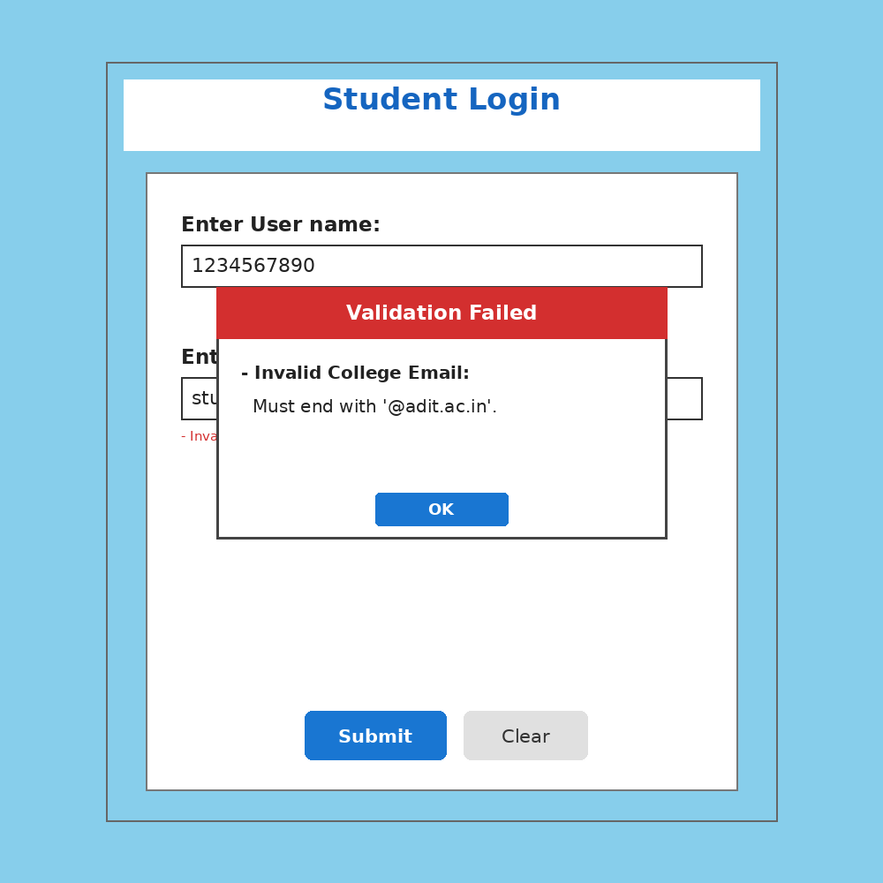
OUTPUT, TESTING AND CONCLUSION
Invalid inputs display a helpful message instead of proceeding
Valid enrollment: 1234567890
Valid email: tirth@adit.ac.in
Invalid email: student@gmail.com
The program uses functions for reusable validation and Tkinter for GUI interaction.
Conclusion: the project demonstrates input validation, regex patterns, event-driven functions and user-friendly feedback.
Example: wrong email domain

